Slide 1

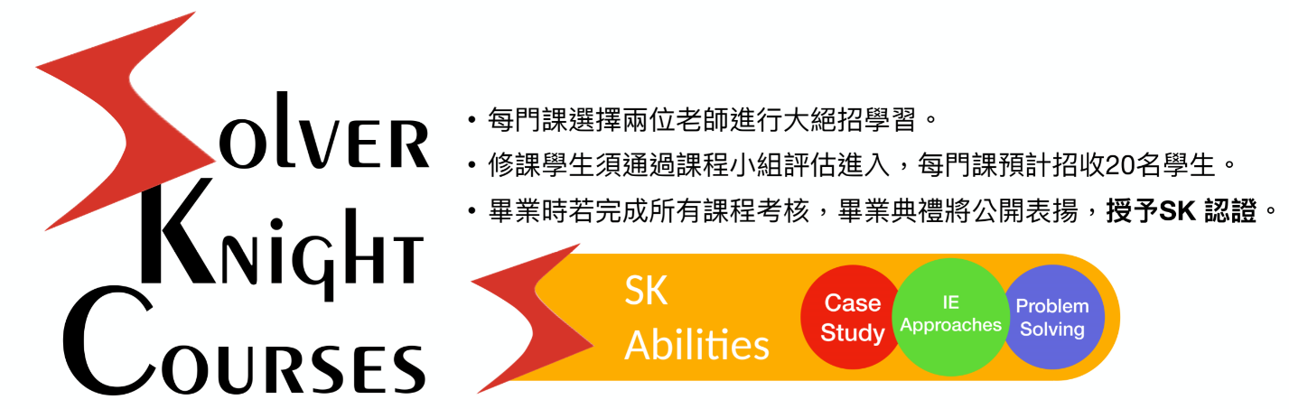
SK計劃介紹
  Solver Knight Program是本系首次推動的全英語特殊培訓課程，培育學生外語能力、資訊整合能力、自學與合作能力、問題解決與分析能力等，將目前所學進行加值，強化學習、降低學用落差，為培育解決跨領域問題人才計劃，以符合產業專業人才需求！
  計畫開課課程：個案分析、問題解決、工業工程方法，畢業前修完這三門課！
  結合系上老師的專業領域，藉由小班制、密集討論、實作為主的教學方式，每門課以英文學習，在老師的指導下完成，最後以展演考核，修課學生須通過課程小組評估加入。

Slide 2

SK計劃課程
115-1授課教師教學內容
課程時間目前可能安排於：
3-CD、5-78
*各教師課程內容規畫會另調整安排
115-1開課課程：個案研究、工業工程方法
115-2開課課程：個案研究、問題解決
116-1開課課程：個案研究、工業工程方法
116-2開課課程：個案研究、問題解決

Slide 3

Simulation – FlexSim and Witness
楊康宏老師
Kendall notations and basic Statistics and Queueing Concepts 1 hour
FlexSim Little Factory (2 hours)
  Source, Sink, Queue, Processor
  Conveyors, Stack, Transporter, AGV
  Global Table, List
Witness Little Factory (2 hours)
  TBD
FlexSim Healthcare Little model (4 hours)
  Process Flow
  People Module
Case study
  Student Group Project

Slide 4
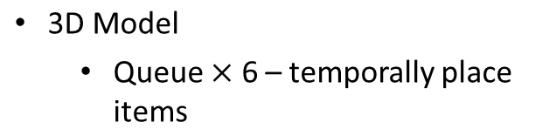
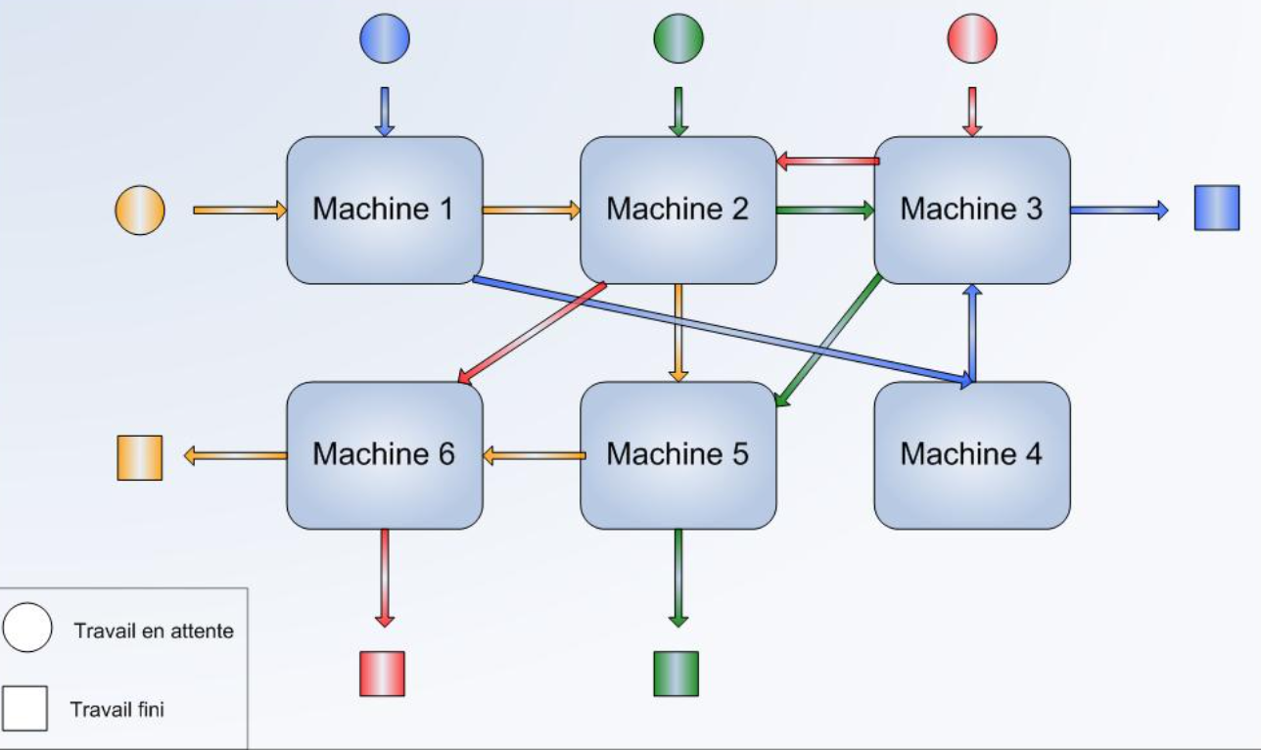
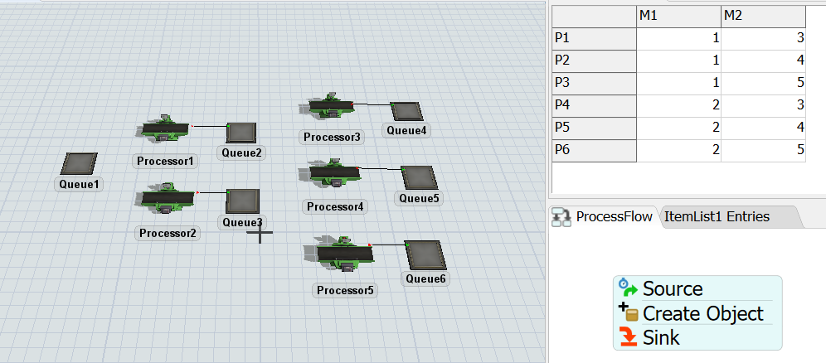
Simple Jobshop System
楊康宏老師
General Process flow
  Source – Generate Token
  Create Object – Generate item (product)
  Sink – Destroy Token
3D Model
  Queue $×$ 6 – temporally place items
  Processor $×$ 5 – proceed items
Tool Box
  Item List
  Global Table

Slide 5
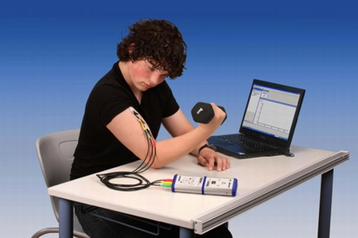
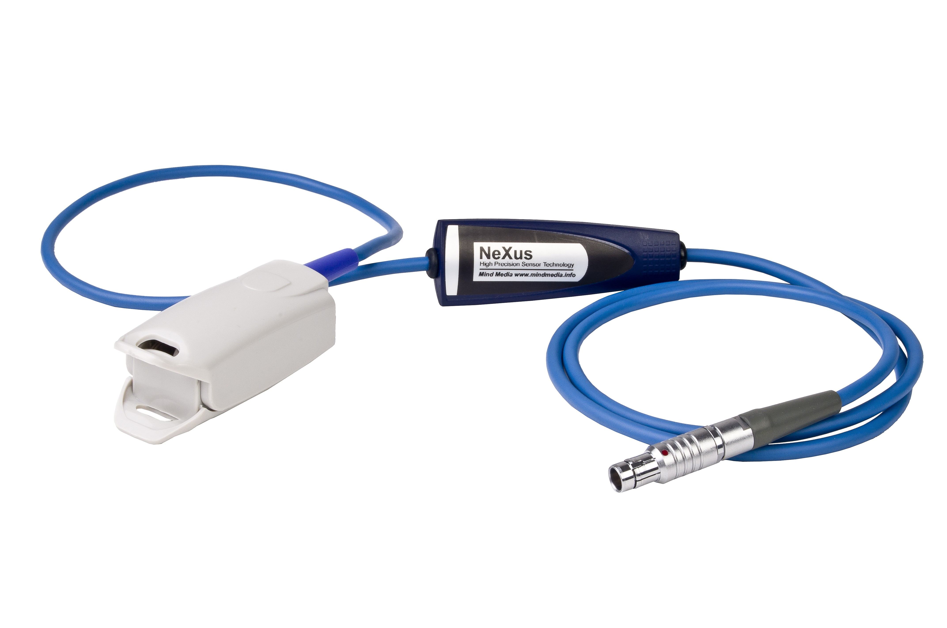

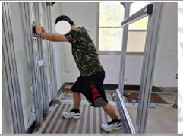

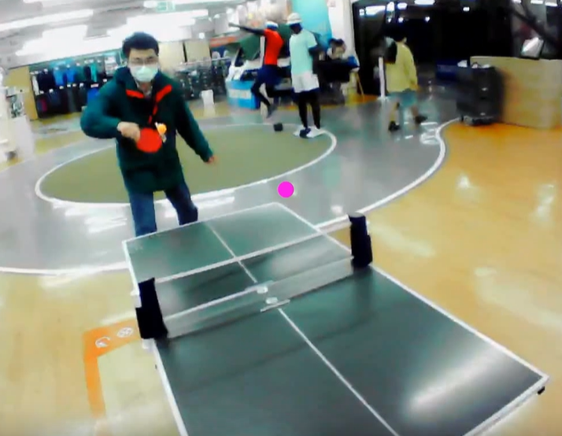
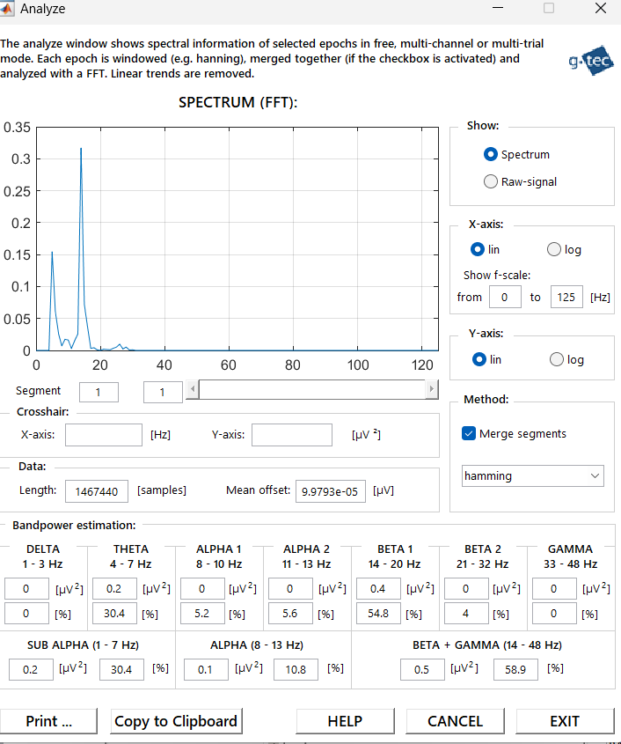
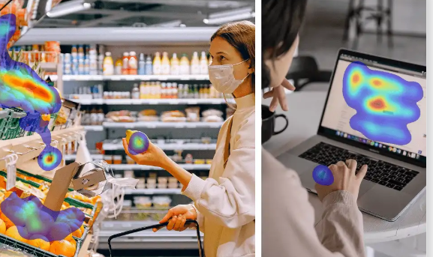
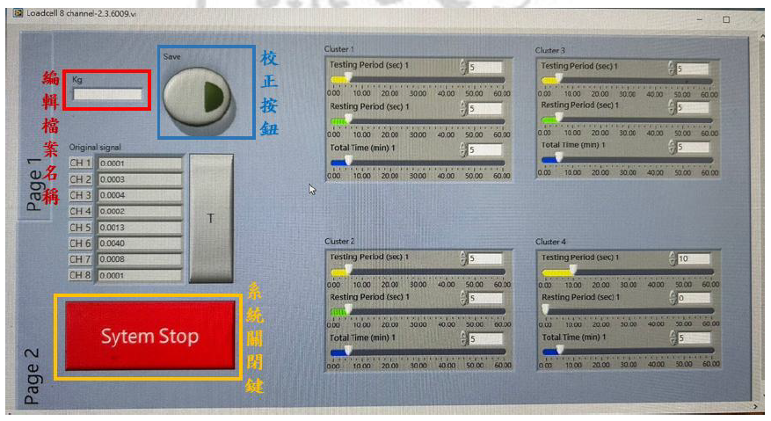

Case study: Ergonomics
個案研究: 人因工程
王珮嘉老師
肌電 (EMG)感測器
手指血流脈衝 (BVP) 感測器
腦電圖 (EEG)
眼動儀 (Eye-tracker)
推拉力設備

Slide 6

Case study: Ergonomics
個案研究: 人因工程
王珮嘉老師
Prerequisite: Motion and Time Study, Ergonomics
Course Design
依實際授課狀況 適時滾動式調整

Slide 7



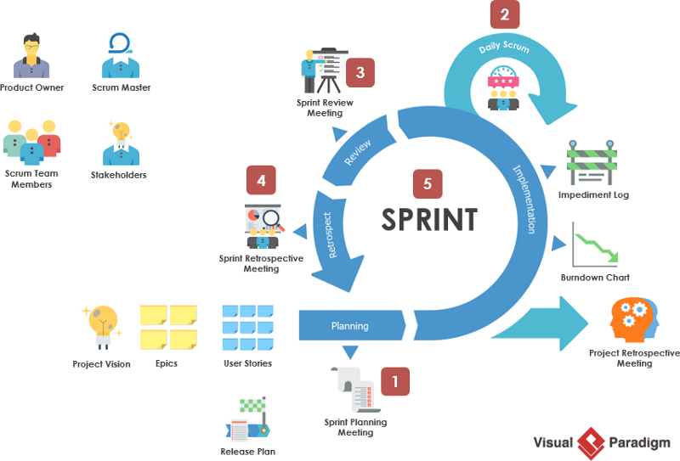
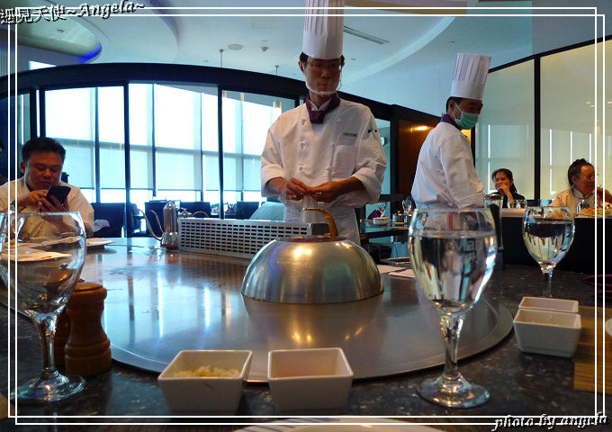
戴淑賢老師
Case Study
(Agile Project Management on Service Innovation)

Slide 8

戴淑賢老師
Case Study
(Agile Project Management on Service Innovation)
Teaching Plan :
Agile Project Management
Feasibility Analysis
Scrum and Spint
Service Quality Perceived by Customers
Service Failure and Recovery
Case study on Service Industry
Service Innovation

Slide 9
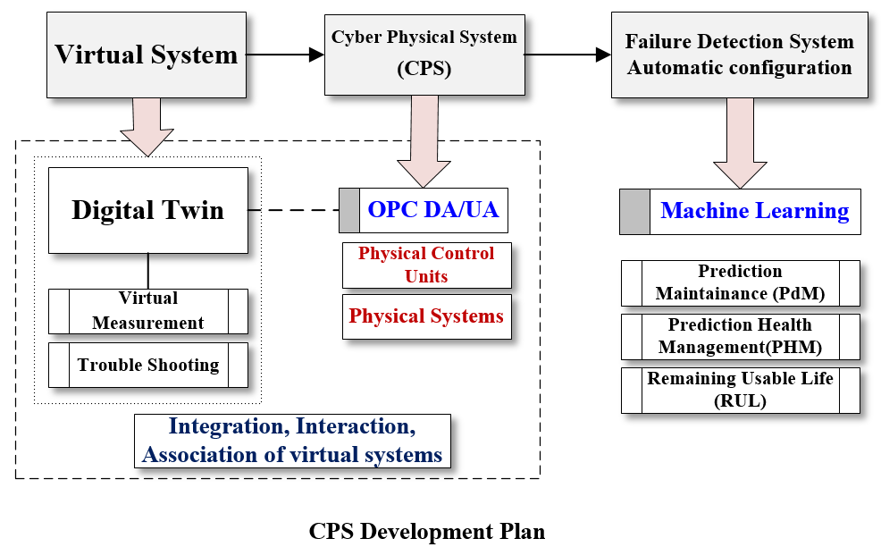
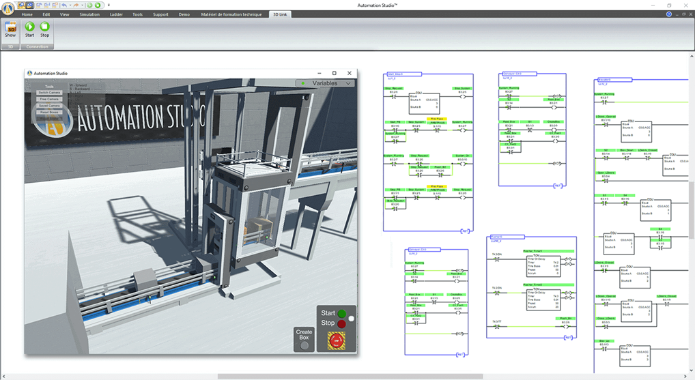
Manufacturing/AI：CPS introduction
黃冠鈞老師
Phase 1: Virtual system development
  Platform：Automation Studio
  Introduction of technologies applied
  to manufacturing systems
  Process control introduction
    Actuators
    Electric control system
    (JIC and IEC standards)
    PLC and Ladder diagrams
    Sequential Function Charts (SFC)
    3D virtual system development
    (Case study and existing equipment)
  Note: Please refer to the figures
  (1) CPS development Plan and
  (2) CPS development details

Slide 10
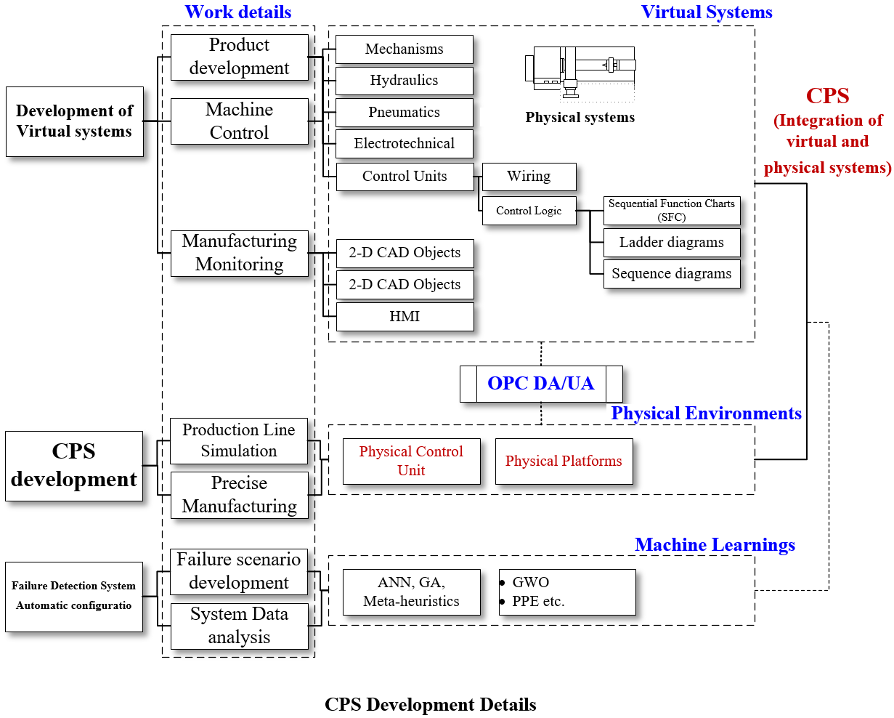
Manufacturing/AI：CPS introduction
黃冠鈞老師
Phase 2: CPS development
  Platform：Automation Studio
  Introduction of physical control units
    Mitsubishi
    Omron
  Introduction of communication
  strategies
    OPC severs
    OPC DA/UA
    Communications
  Note: Please refer to the figures
  (1) CPS development Plan and
  (2) CPS development details

Slide 11
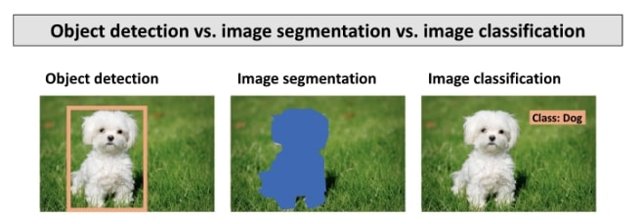
AI Technology for Computer Vision Application(1/2)
趙怡翔老師
Source: https://levity.ai/blog/what-is-an-image-classifier
Course Objectives
  To learn the SOTA Object Detection and image segmentation method : YOLOv9

Slide 12
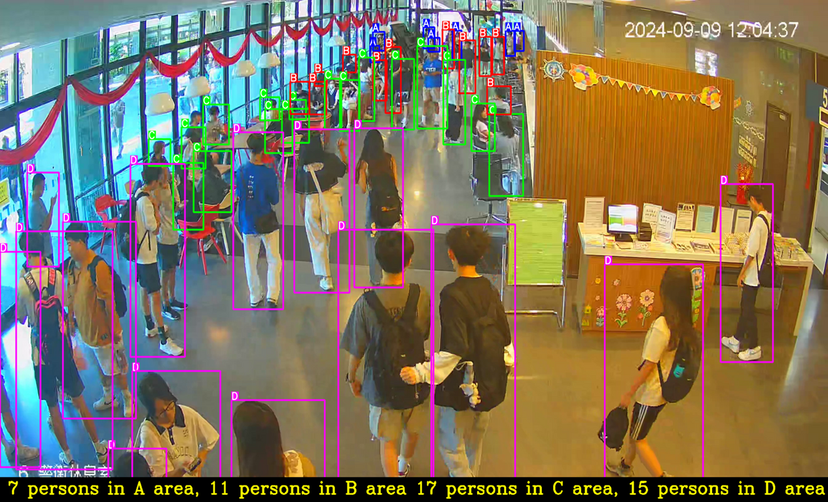
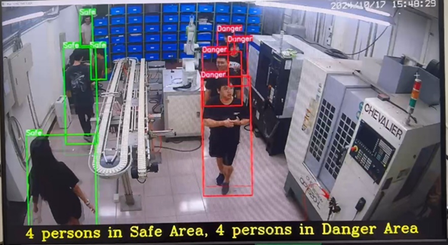
AI Technology for Computer Vision Application(2/2)
趙怡翔老師
Course Outline
  What is Object Detection and Image Segmentation ?
  Fundamentals of Convolutional Neural Network (CNN)
  The Object Detection and Segmentation method : YOLOv9
  The implementation of YOLOv9 using Pytorch library
    Train a YOLOv9 model using the image training dataset
    Inference the image testing dataset using your YOLOv9 model
AI real-time Field Crowd Surveillance Application
Industrial Safety Surveillance Application

Slide 13





彭翊鈞老師
Metaheuristic Algorithm I
Genetic Algorithm (GA)
0 | 0 | 0 | 0 | 0 | 1
Parents
Population
1 | 1 | 1 | 1 | 1 | 0
This course will focus on the GA, a very common type of Metaheuristic Algorithm, which is suitable for situations where the best answer is sought among many choices.
※GA is applicable to many Industrial Engineering problems in Management Science and Operations Research.
0 | 1 | 0 | 1 | 0 | 1
0 | 0 | 0 | 0 | 0 | 1
Crossover
1 | 1 | 1 | 1 | 1 | 0
Course Objectives:
Understand the basic concepts and operation principles of GA.
Learn to design and implement simple GA to solve practical problems.
Explore the practical applications of GA in management science and operations research.
Crossover Point
0 | 0 | 0 | 1 | 1 | 0
Offspring
1 | 1 | 1 | 0 | 0 | 1

Slide 14



彭翊鈞老師
A
10
B
Metaheuristic Algorithm II
Travelling salesman problem (TSP)
The application of metaheuristic algorithm.
15
12
20
17
The Travelling Salesman Problem (TSP) is a classic combinatorial Optimization problem.
The goal is to find the shortest possible route that allows a salesman to visit each city exactly once and return to the starting city.
TSP is widely used in Logistics, Routing, and Scheduling applications.
E
C
11
A
10
B
Course Objectives:
Understand the definition and challenges of the TSP.
Learn how to apply GA, PSO, and SA to solve the TSP and compare their effectiveness and characteristics.
15
12
E
C
11

Slide 15
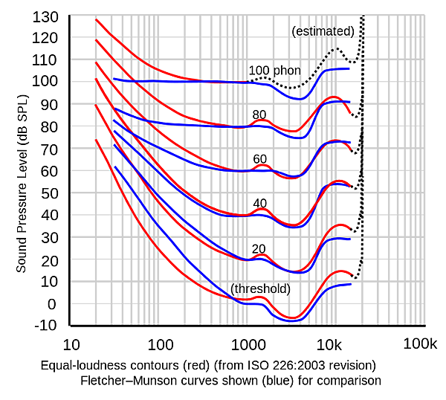
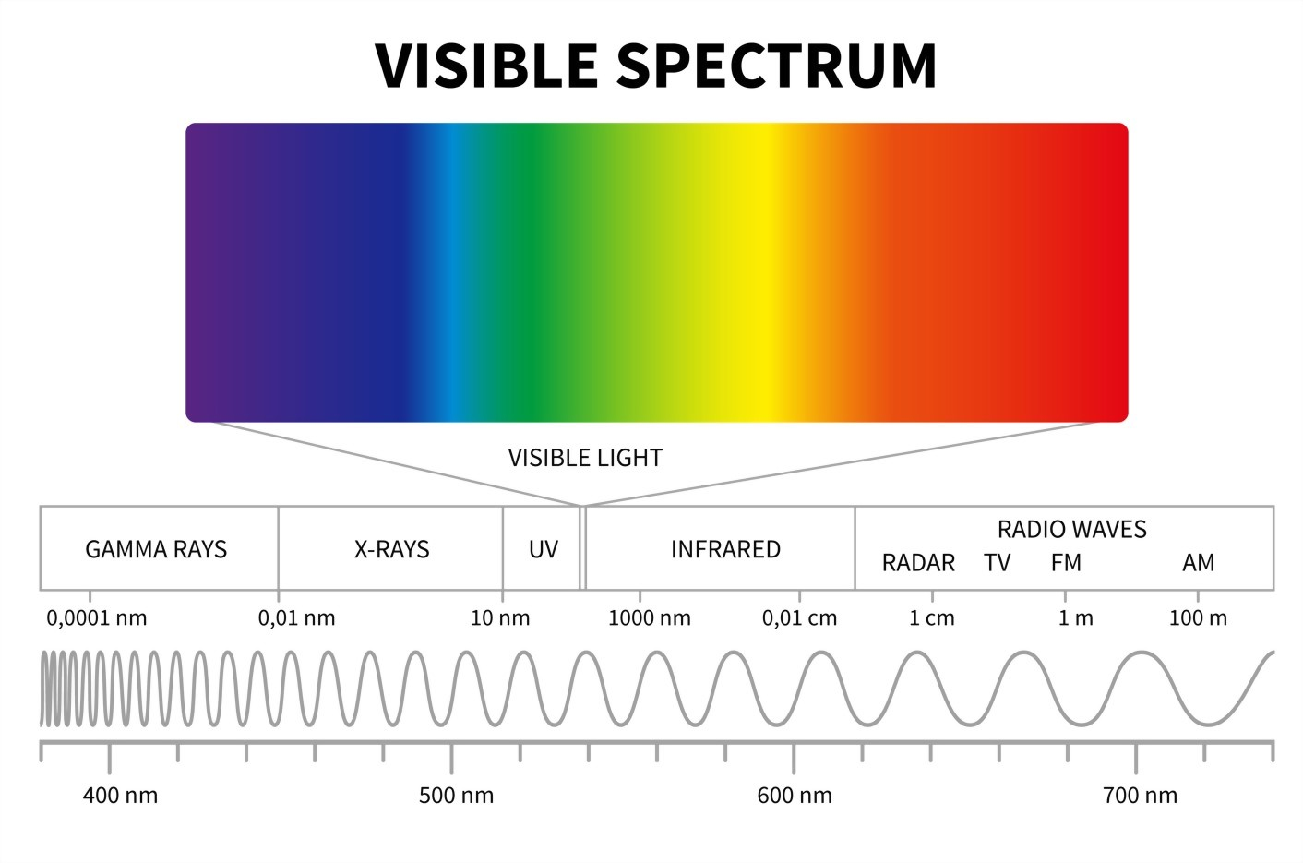
趙怡翔老師
謝閔智老師
Human factors in lighting and sound
Learn about lighting-related knowledge
Understand the impact of lighting on user
Learn about sound-related knowledge
Understand the impact of sound on user

Slide 16
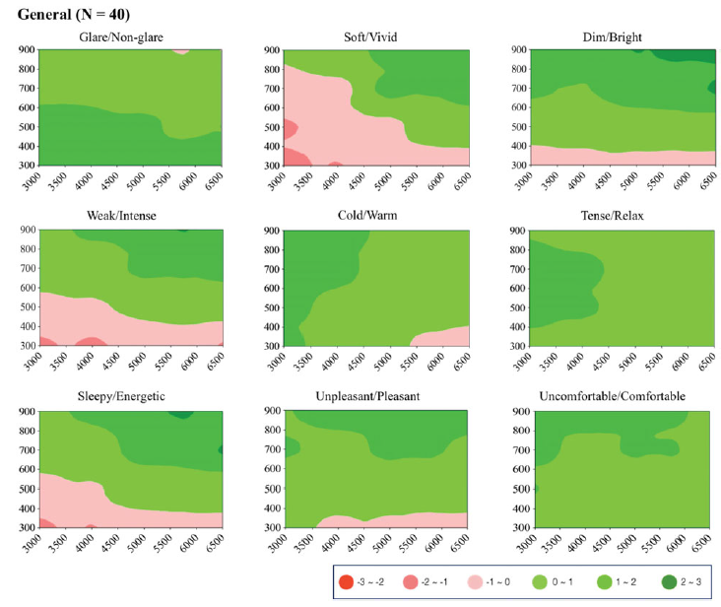
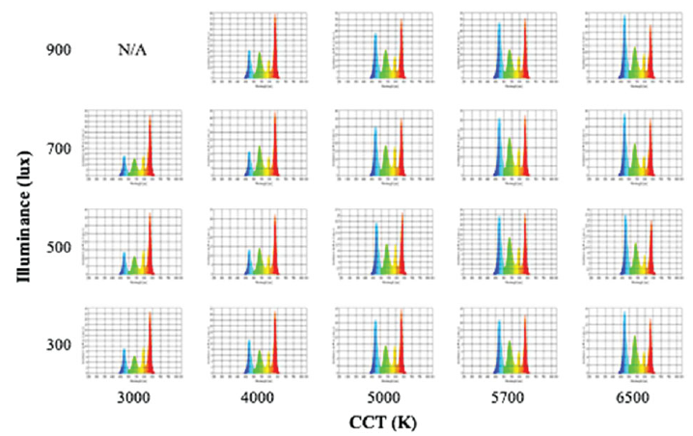
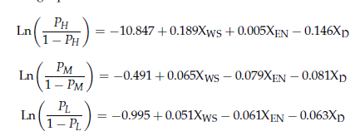
趙怡翔老師
謝閔智老師
Human factors in lighting and sound
Through experiments, understand the interaction between humans and lighting environments.
Using deep learning, model human behavior in lighting environments.
Through experiments, understand the interaction between humans and sound environments.
Using deep learning, model human behavior in sound environments.

